Slide 1
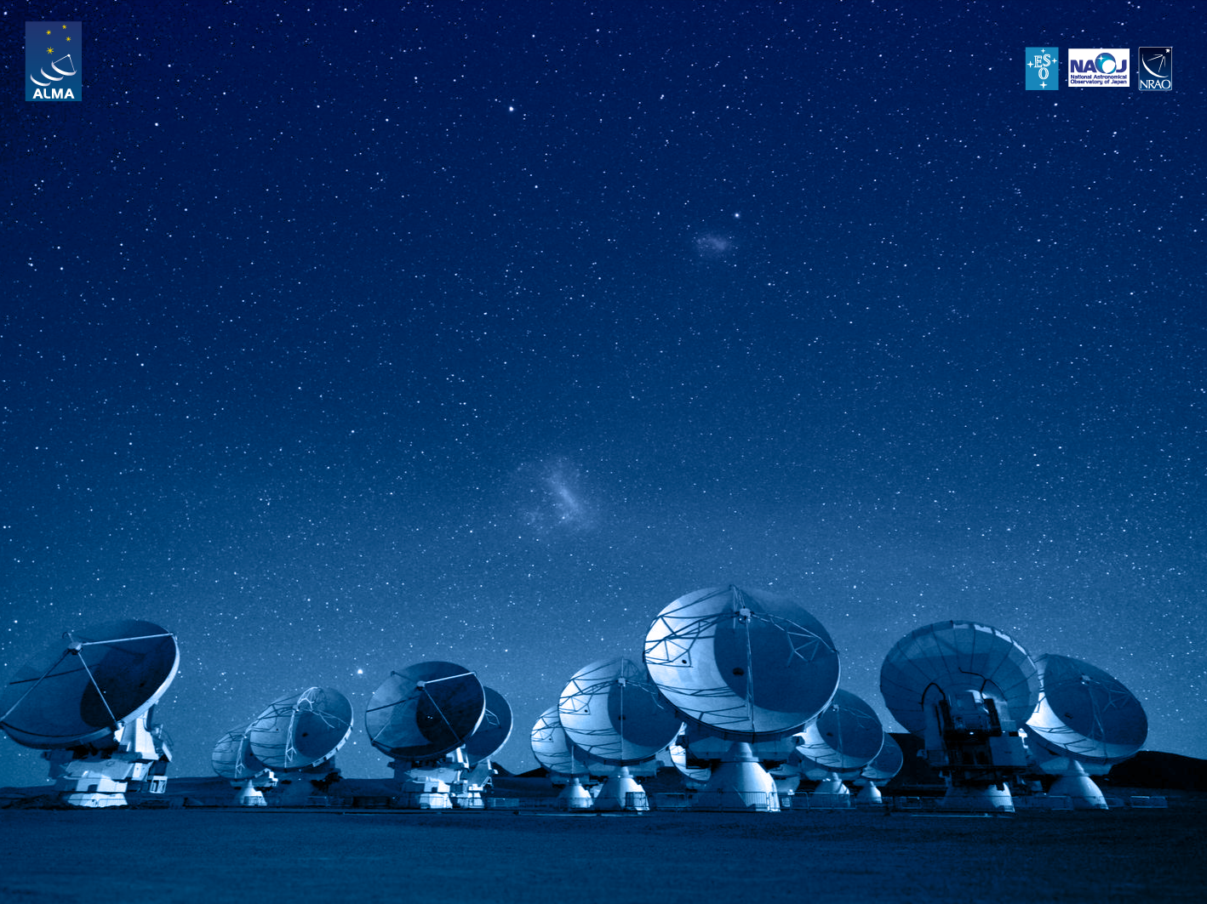
ALMA Common Software Basic Track
Characteristic components
BACI properties and DevIO classes

Slide 2
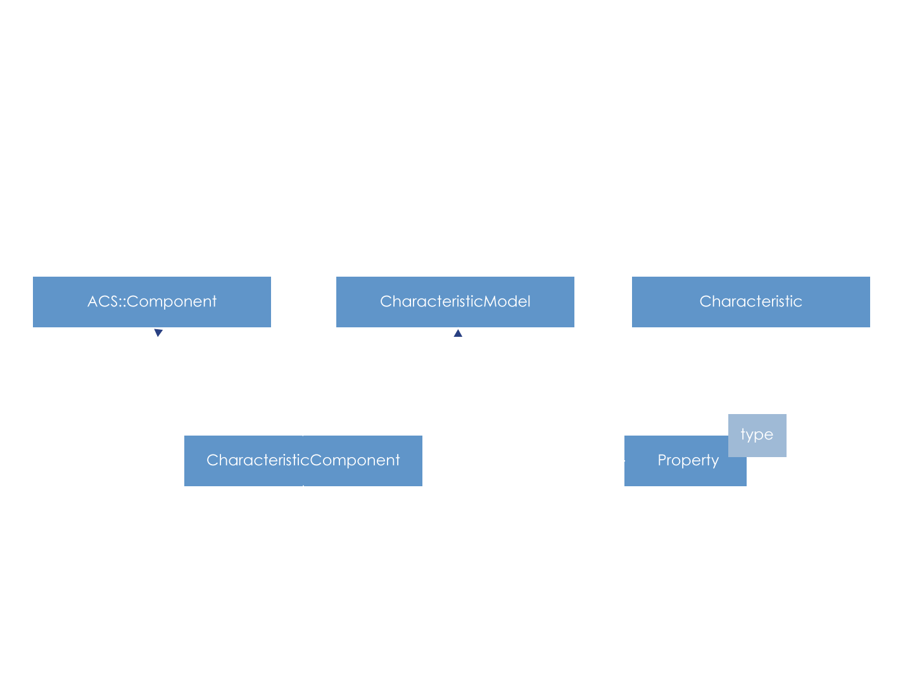
Components and characteristics components

Slide 3
Components and characteristics components
Object, can be a distributed object
Executed within a container running on a given machine
Container spawns threads for component execution
A Component is the natural base class for physical and logical “devices”
Follows a component lifecycle
A characteristic component aggregates BACI properties of different data types
Characteristics: static data store in the CDB
units, default values, monitor*, alarm*, archive*
Abstraction of hardware devices

Slide 4
BACI property
It is an statically defined item
It has a value and attributes
The value is strongly typed
Only basic types are available
double, long, string, pattern, enum, longSeq
limited unsigned support!
Read-only (RO) and read-write (RW) access
Defines a C++ interface, which is extended by developer
Developer implements functions read() and write() functions
Combines value(s) with “attributes”
Description
Unit
Monitoring parameters
Alarms thresholds

Slide 5
BACI property (continued)
All properties have the same attributes!
This cannot be modified
Get / set methods
Synchronous and asynchronous
Value monitoring
Interval
On change
Keeps history (last 10 values)
Value archiving
Same as for monitoring
Alarms build-in

Slide 6
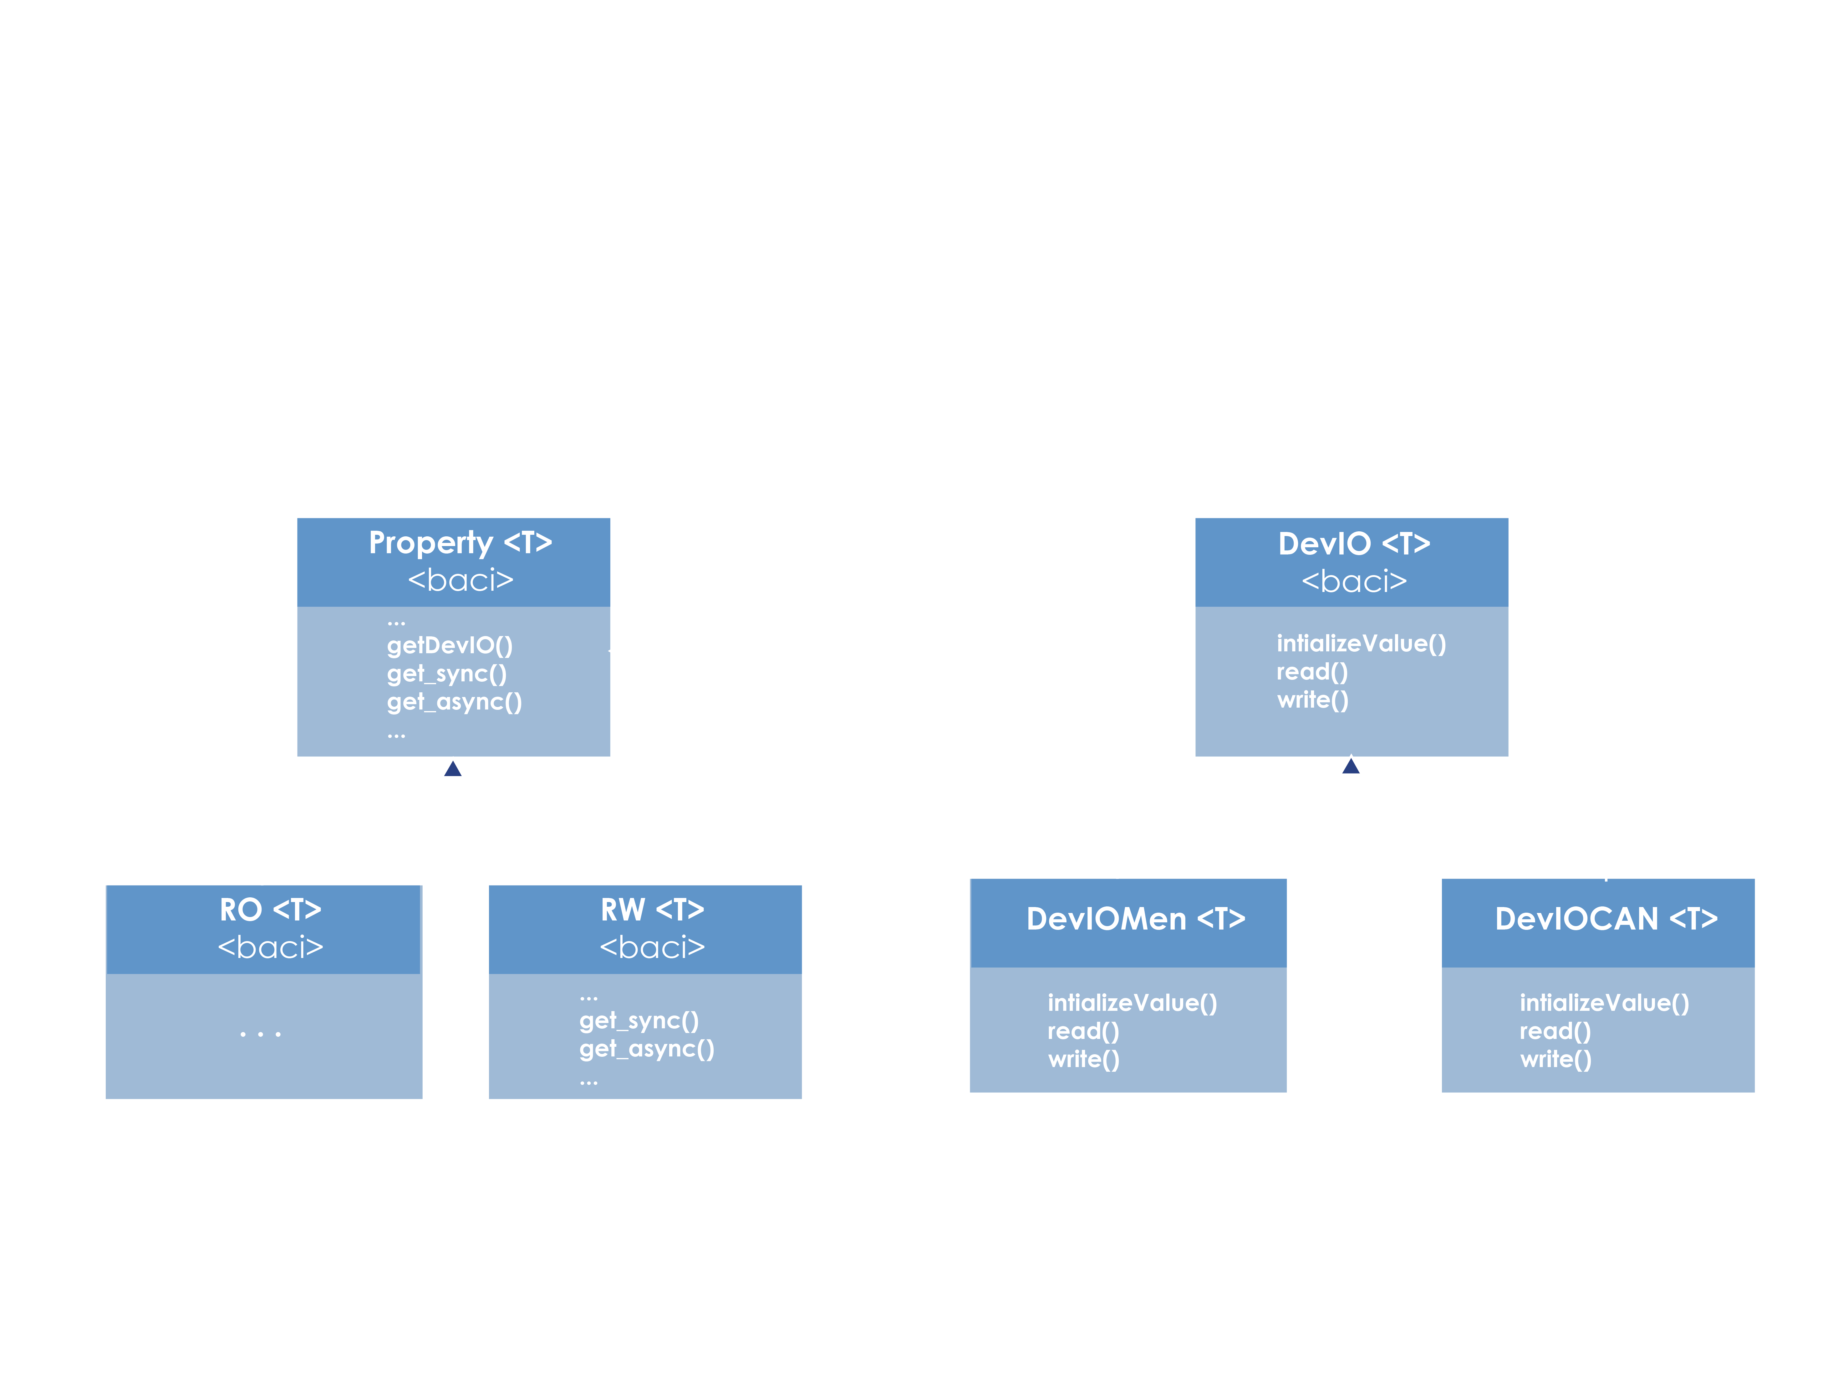
DevIO classes

Slide 7
DevIO classes
Provides the “value” part in BACI properties
Can be extended for real hardware
Can be extended for simulation purposes (f.i. DevIOMem)
Does not prevent race conditions
Does not take care of device init, etc.
Does not do error handling when hardware fails
Decouple software and hardware implementing a bridge pattern
read() / write() / initializeValue() methods can be overloaded

Slide 8
DevIO example class: DevIOMem
Inherits from DevIO
Useful for simulation and testing
Implements read(), write(), initializeValue() methods
Very flexible

Slide 9
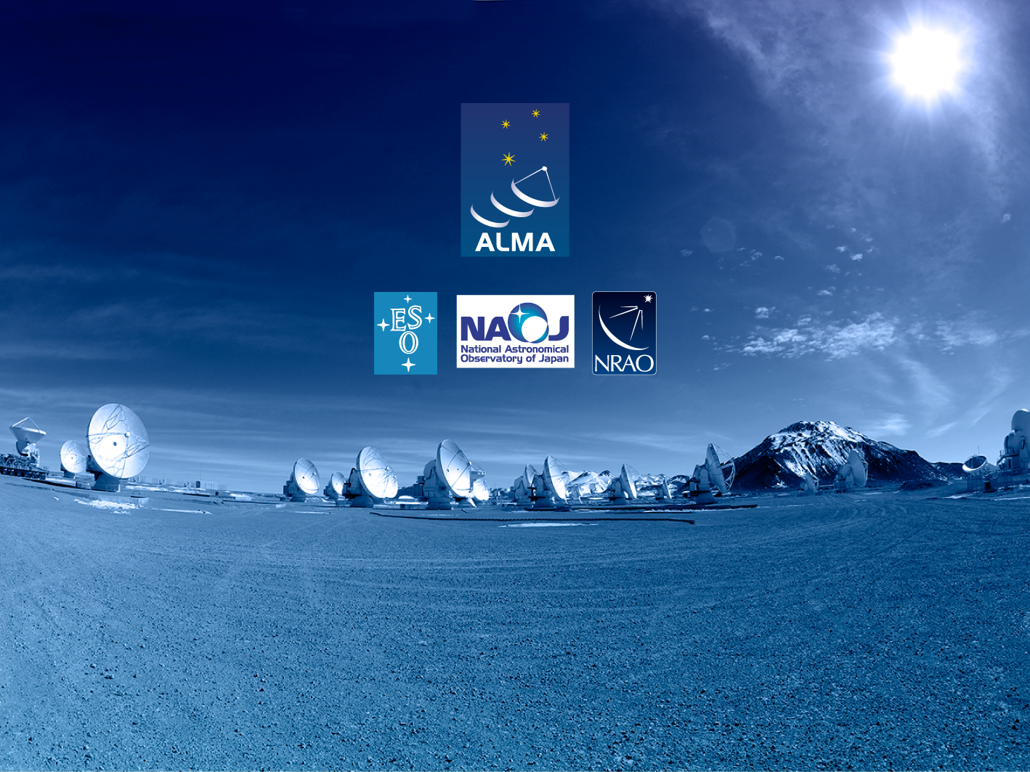
Questions?
Acknowledgements
ACS presentations were originally developed by the ALMA Common Software development team and has been used in many instances of training courses since 2004. Main contributors are (listed in alphabetical order): Jorge Avarias, Alessandro Caproni, Gianluca Chiozzi, Jorge Ibsen, Thomas Jürgens, Matias Mora, Joseph Schwarz, Heiko Sommer.
The Atacama Large Millimeter/submillimeter Array (ALMA), an international astronomy facility, is a partnership of Europe, North America and East Asia in cooperation with the Republic of Chile. ALMA is funded in Europe by the European Organization for Astronomical Research in the Southern Hemisphere (ESO), in North America by the U.S. National Science Foundation (NSF) in cooperation with the National Research Council of Canada (NRC) and the National Science Council of Taiwan (NSC) and in East Asia by the National Institutes of Natural Sciences (NINS) of Japan in cooperation with the Academia Sinica (AS) in Taiwan. ALMA construction and operations are led on behalf of Europe by ESO, on behalf of North America by the National Radio Astronomy Observatory (NRAO), which is managed by Associated Universities, Inc. (AUI) and on behalf of East Asia by the National Astronomical Observatory of Japan (NAOJ). The Joint ALMA Observatory (JAO) provides the unified leadership and management of the construction, commissioning and operation of ALMA.

